Slide 1
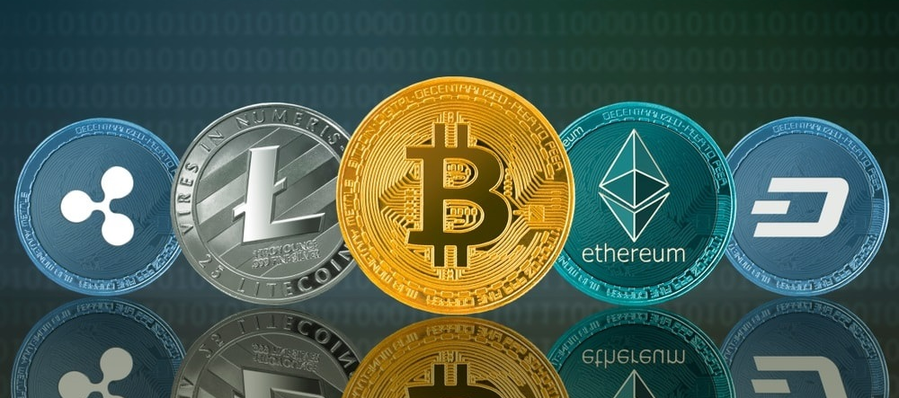
Portfolio Optimization– Crypto Currency
Shinan

Slide 2
Crypto currency – Digital asset for illustration purpose only
Gold vs Bitcoin (digital gold per say)
1 ounce of gold ≈ 0,031kg
Is it possible to carry 1 Trillion Dollar (1 ounce ≈1.770$ as of 17.02.21 )?
NONO 1 T$ ≈17,514,124 kg gold
YES 1 wallet BTC address which is just a line of hash code.

Slide 3
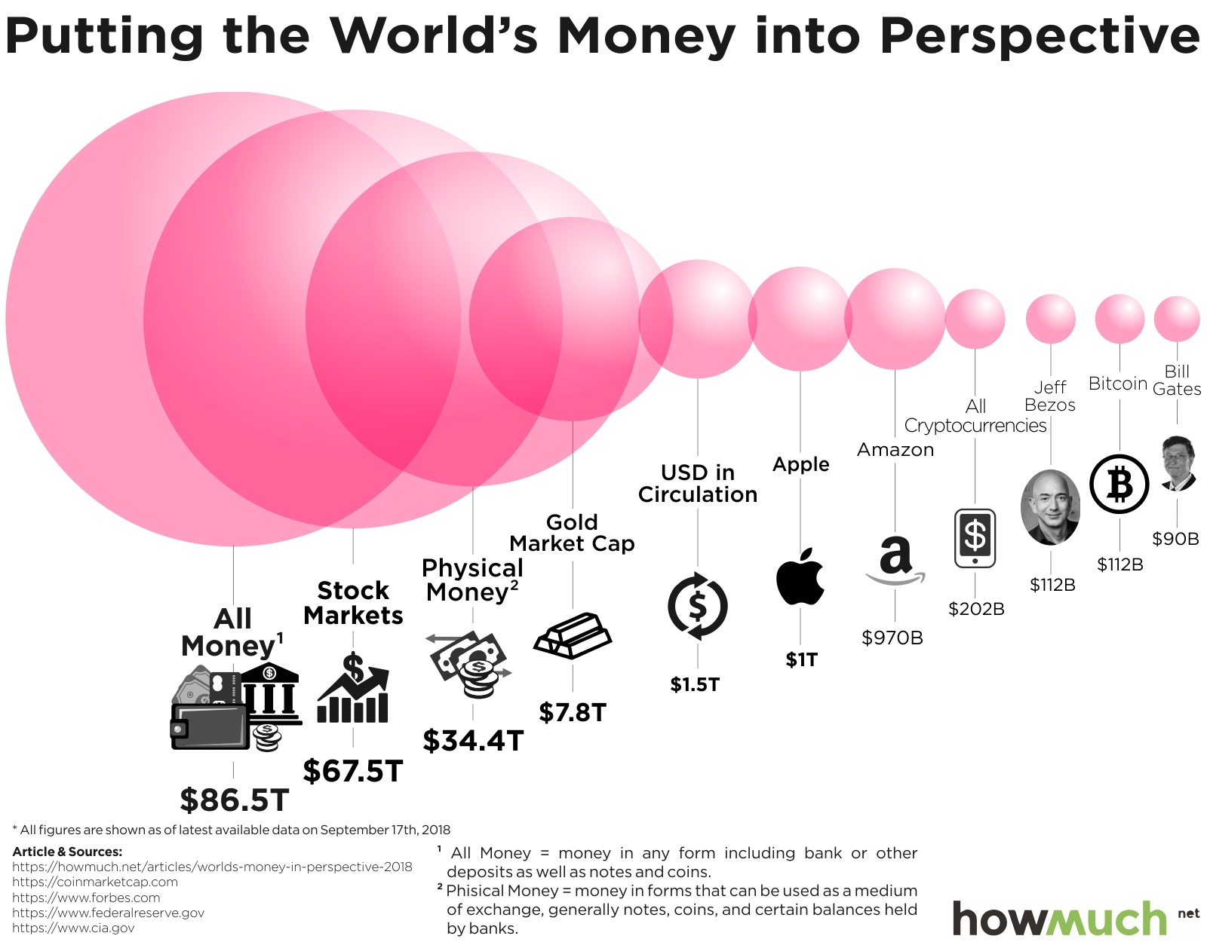
Why I think it has potential?
For illustration purpose only

Slide 4
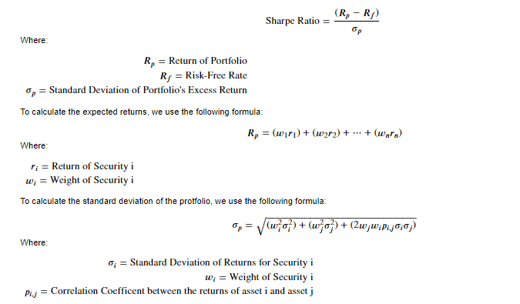
Applying Monte Carlo Simulation to optimize the portfolio rely on repeated random sampling to obtain numerical results. The underlying concept is to use randomness to solve problems that might be deterministic in principle. They are often used in physical and mathematical problems and are most useful when it is difficult or impossible to use other approaches. Monte Carlo methods are mainly used in three problem classes:^{[1]} optimization, numerical integration, and generating draws from a probability distribution. From wiki
Data : downloaded from Coingecko API
01.01.19 to 31.12.19 for 10 crypto currencies with the highest market cap
Used metrics: return, volatility (std), Sharpe ratio which are standard measurements on the traditional assets class such as for stocks.
Objectives: optimize the portfolio in term of the metrics

Slide 5
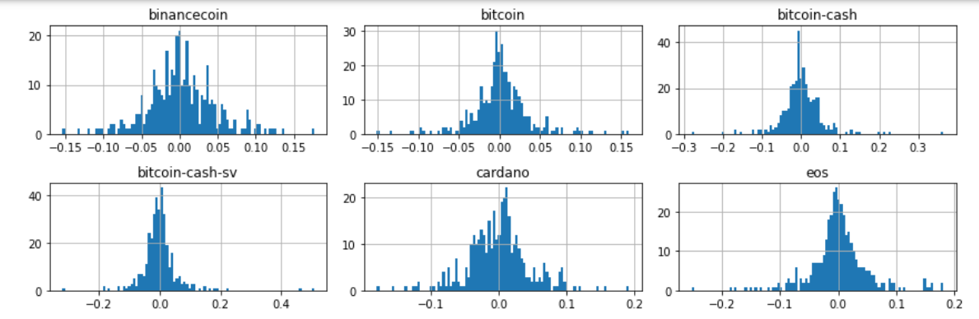
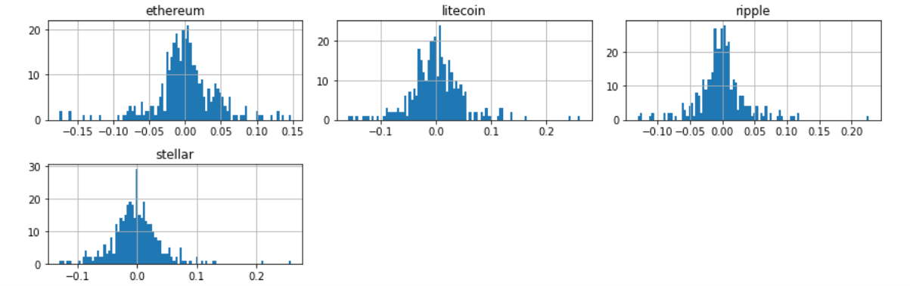
Applying Monte Carlo Simulation to optimize the portfolio

Slide 6
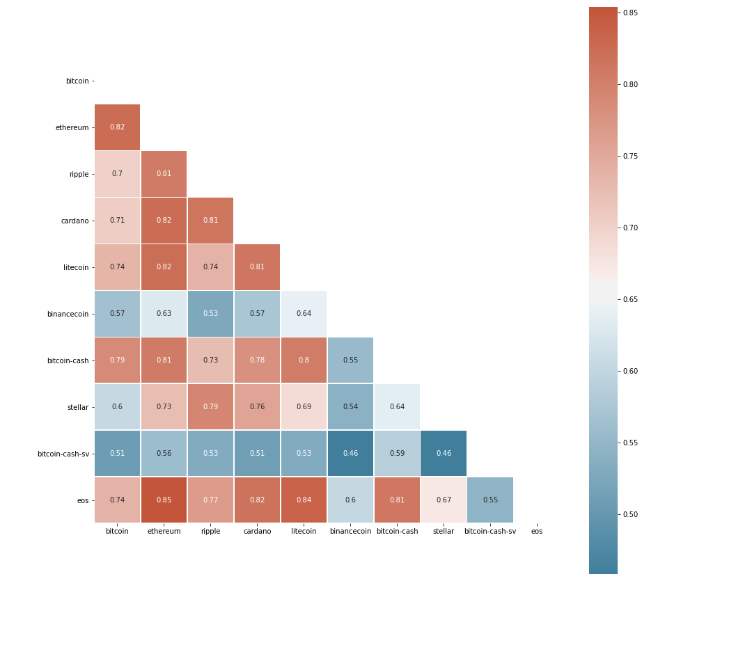
The majority coins are highly correlated to each other except Binance Coin and BSV.
Normally we should build the portfolio with lower correlated assets.

Slide 7
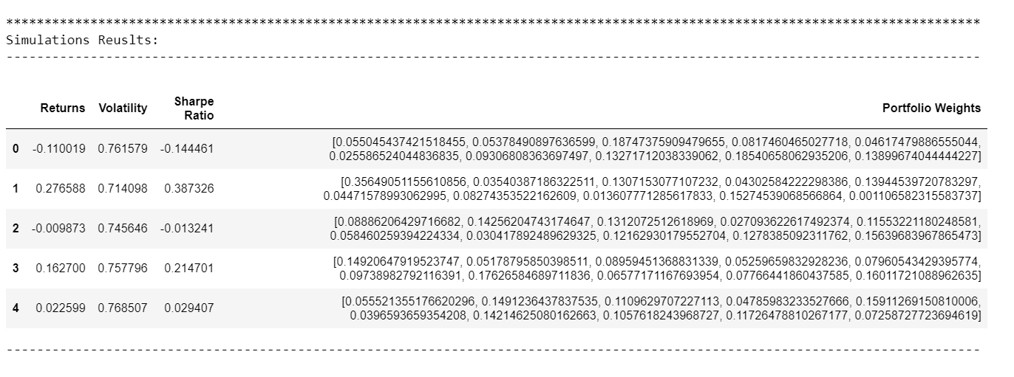
Simulation results : It ran 10.000 times and the results stored in an a dataframe

Slide 8
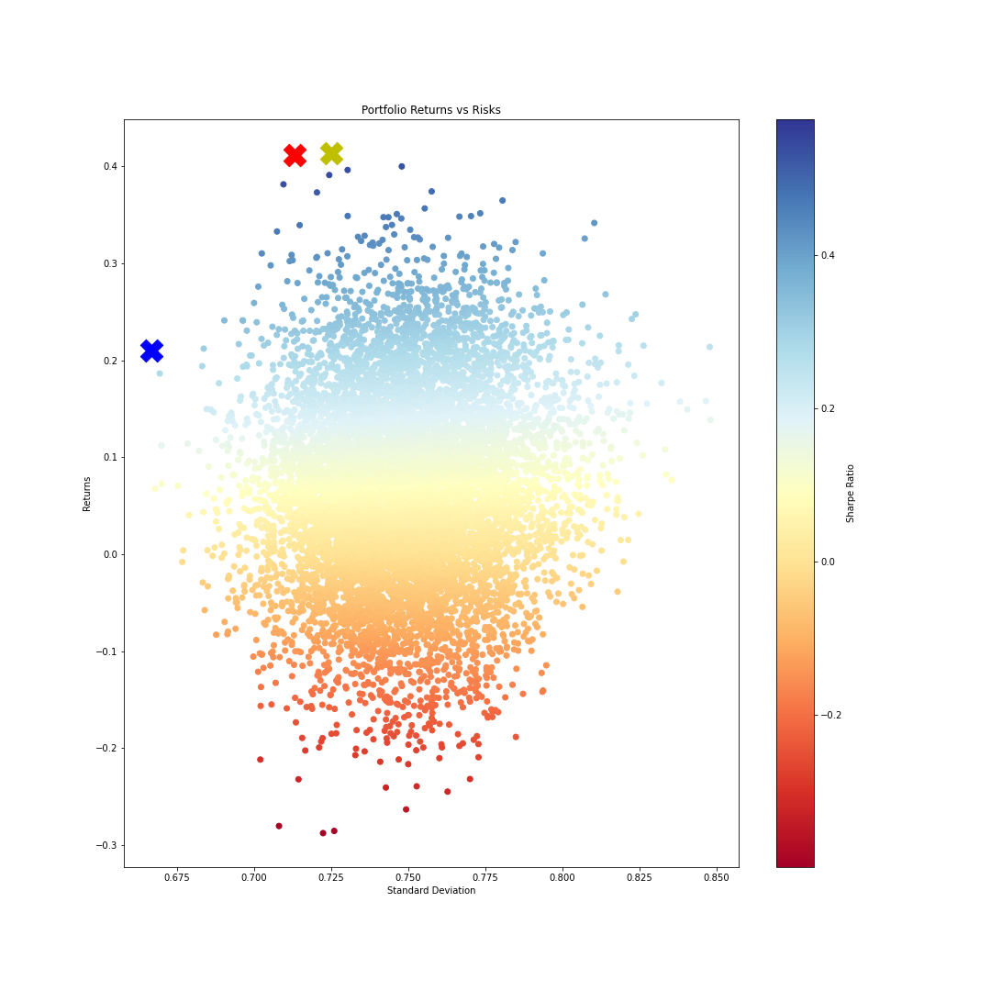
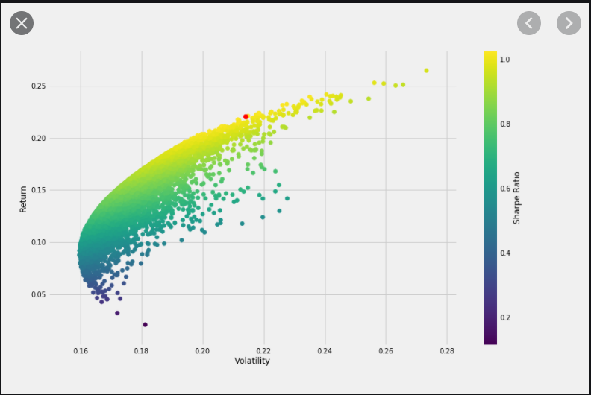
Plotting results x : highest sharpe ratio x : highest return x : lowest vol

Slide 9
Allocation of the fund
Coins | Max Sharpe Ratio | Max Returns | Min Volatility | Min Sharpe Ratio | Min Returns
BTC | 0.26 | 0.24 | 0.25 | 0.03 | 0.00
ETH | 0.04 | 0.00 | 0.05 | 0.08 | 0.11
XRP | 0.02 | 0.05 | 0.23 | 0.28 | 0.24
ADA | 0.03 | 0.10 | 0.08 | 0.04 | 0.24
LTC | 0.24 | 0.05 | 0.06 | 0.05 | 0.02
BNB | 0.24 | 0.27 | 0.22 | 0.01 | 0.08
BCH | 0.02 | 0.21 | 0.01 | 0.07 | 0.04
Stellar | 0.06 | 0.01 | 0.02 | 0.40 | 0.21
BSV | 0.06 | 0.03 | 0.08 | 0.04 | 0.03
EOS | 0.04 | 0.03 | 0.00 | 0.02 | 0.03

Slide 10
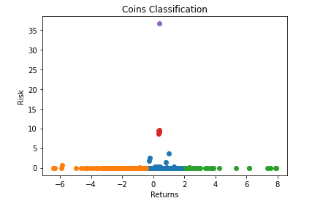
Classification with 1.883 different coins Data: API Coingecko available coins with return from 01.08.19 to 31.12.19

Slide 11
Disclaimer
All the information in the ppt is no investment advice.
2. I personally think capital market is very brutal, just like a war. It follows generally 20:80 rule.
3. I am a believer in long term investment because I prefer to spend time to understand what I have invested in and what is the macro trend in the market.

Slide 12

Any Question?

